Slide 1

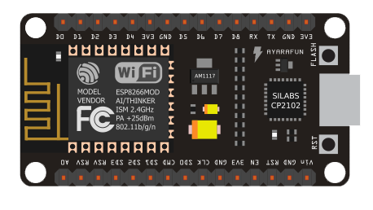



EC2 virtual machine
Humidity sensor
Hosts
Temperature sensor
Soil moisture sensor
CT Bot
UI dashboard
Telegram Message

